Slide 1

Hybrid Cloud Data Movement
Data Engineering Batch 1
PROJECT 1
Akilesh K

Slide 2
Project Statement
Implement a solution that involves moving data between on-premises data sources and Azure cloud using Azure Data Factory, and perform data processing tasks in Azure Databricks.
Analysis
Set up a SQL server with a database.
Utilize Azure Data Factory to transfer data from the SQL database to Blob storage .
Employ Azure Databricks for performing necessary data transformations using PySpark.

Slide 3
Project Overview
The project entails orchestrating a data pipeline to facilitate seamless data movement between on-premises data sources and the Azure cloud environment.
a SQL server will be set up, along with the creation of a database to house the source data. Azure Data Factory will play a pivotal role in this process, acting as the conduit for transferring data from the SQL database to Blob storage.
This transfer will be facilitated by utilizing a self-hosted integration runtime, ensuring secure and efficient data transmission.
Azure Databricks will be leveraged to execute essential data transformation tasks using PySpark, enabling the manipulation and refinement of the ingested data.
the solution aims to streamline data integration and processing workflows, enhancing data accessibility and usability within the Azure ecosystem.

Slide 4
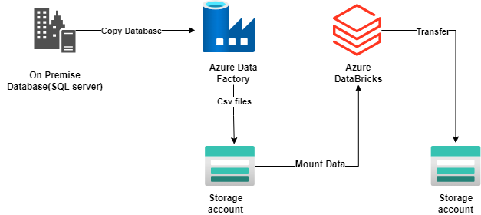
Architecture diagram

Slide 5
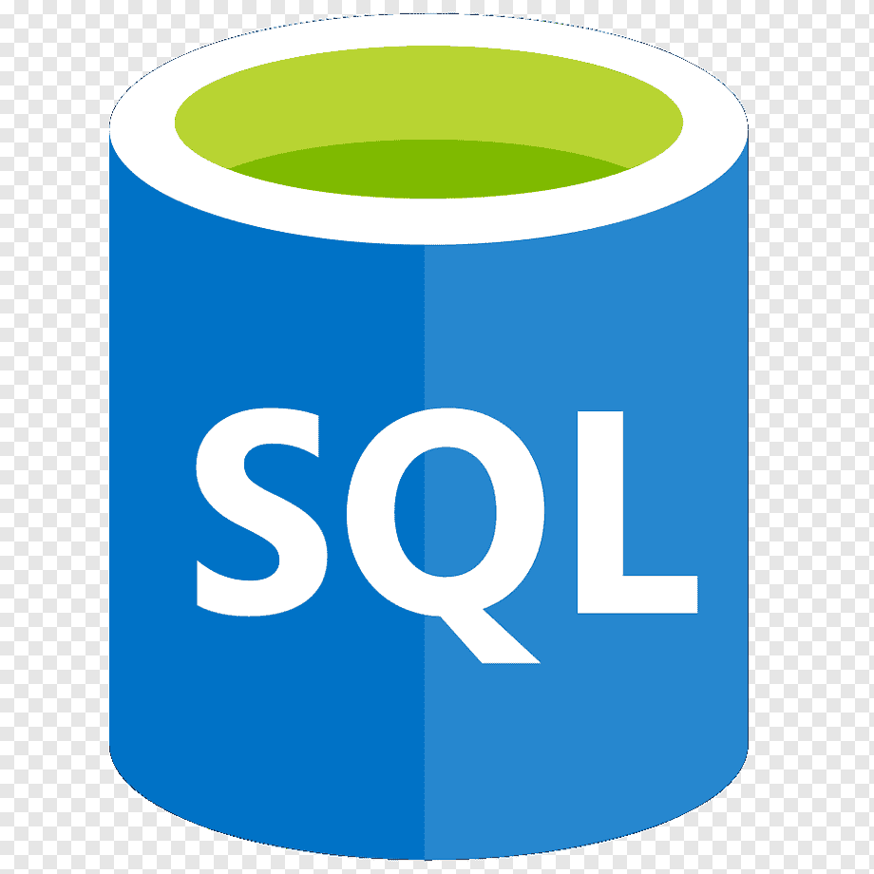
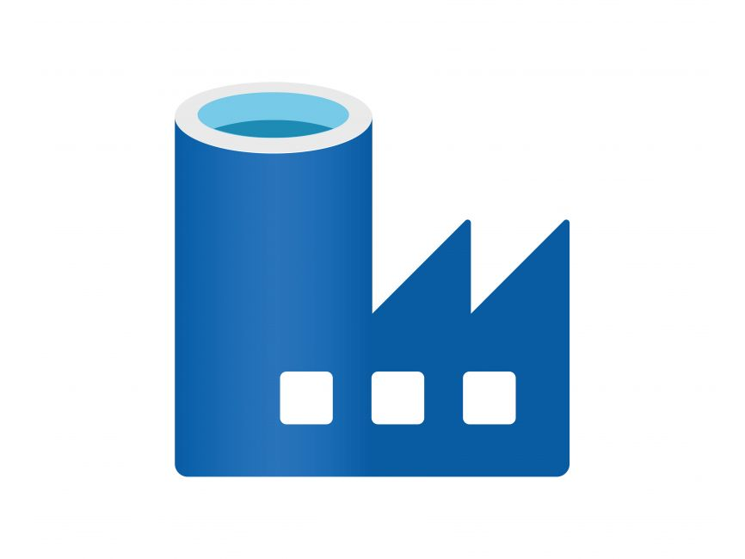


Resources Used for this Project:
SQL server
Azure Data Factory (ADF):
Azure Blob Storage:
Azure Databricks:

Slide 6
Project Requirements
Setting up Data Sources
Azure Data Factory Configuration
Data Movement with Azure Data Factory
Data Processing with Azure Databricks
Transfer of Dataframe to storage

Slide 7
Tasks performed
Set up SQL Server with a database, create schema, and add data.
Create a new user with SQL Server Authentication as System Admin.
Create Azure storage account and blob container.
Set up an Azure Data Factory account and configure a data pipeline for data transfer.
Install self-hosted integration runtime on-premises for SQL Server connection.
Mount blob storage to Azure Databricks and read CSV file into dataframe.
Perform data transformations including aggregation, sorting, and joining.
Profile data to assess quality and characteristics.
Visualize data using pie chart representation.
Transfer manipulated dataframe to blob storage

Slide 8
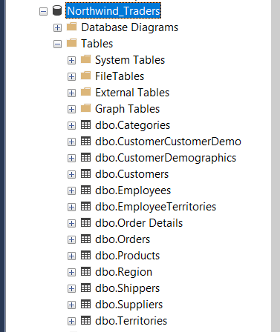
SQL server Database

Slide 9
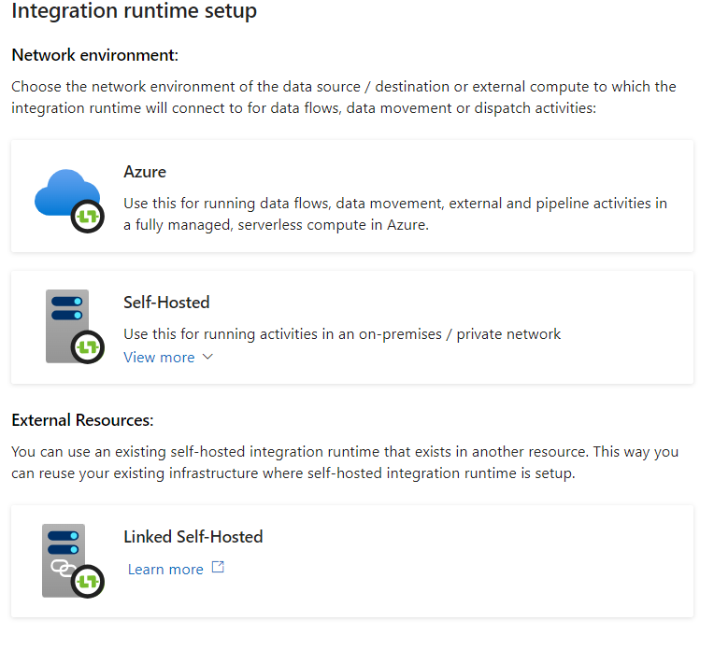
Integration runtime setup

Slide 10
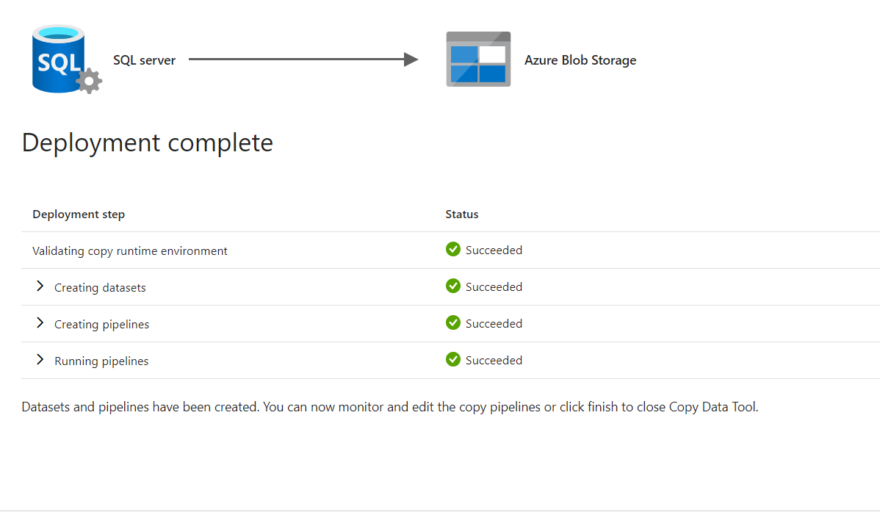
On premise to Azure storage

Slide 11
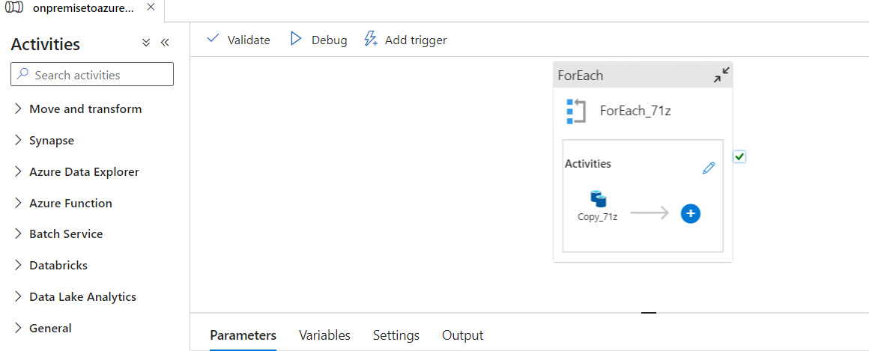
Data Pipeline in azure data factory

Slide 12
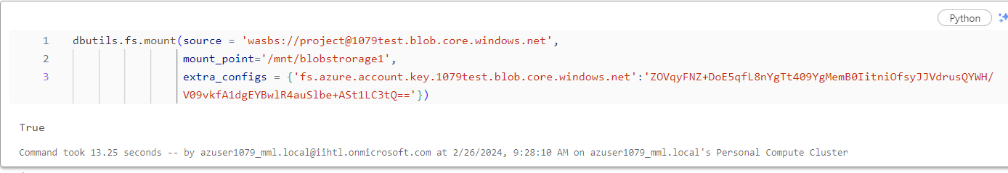
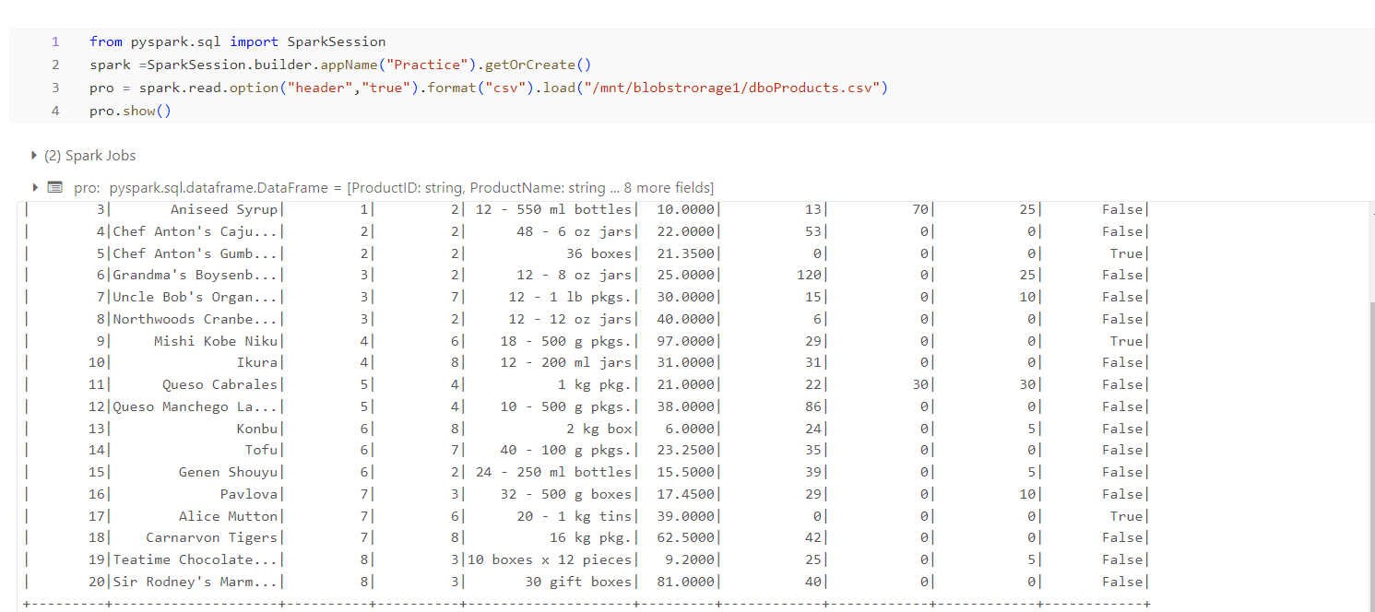
Mount data to azure databricks

Slide 13
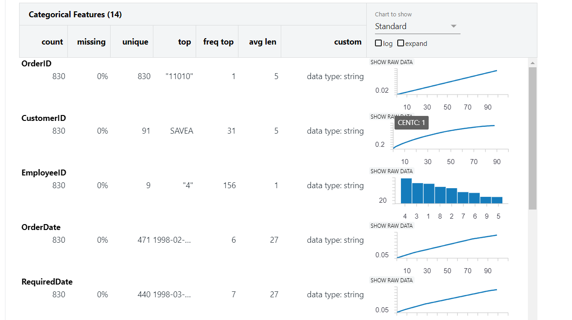
Data Profiling

Slide 14
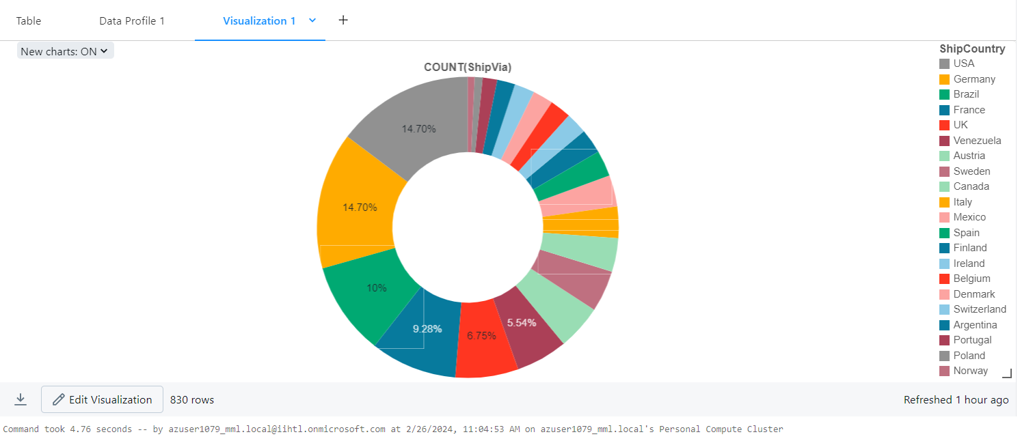
Data Visualization

Slide 15
Conclusion
In conclusion, the project successfully implemented a robust data pipeline leveraging various Azure services. By setting up a SQL server with a database, data was securely stored on-premises. Azure Data Factory was then employed to seamlessly transfer data from the SQL database to Blob storage in the Azure cloud, ensuring scalability and reliability. Additionally, Azure Databricks played a crucial role in performing data transformations and enabling visualization using PySpark, empowering data analysts and engineers to derive insights and make informed decisions. Overall, this project demonstrates the power of Azure services in building end-to-end data solutions, from ingestion to transformation and visualization, paving the way for efficient data-driven workflows and analytics.

